Slide 1
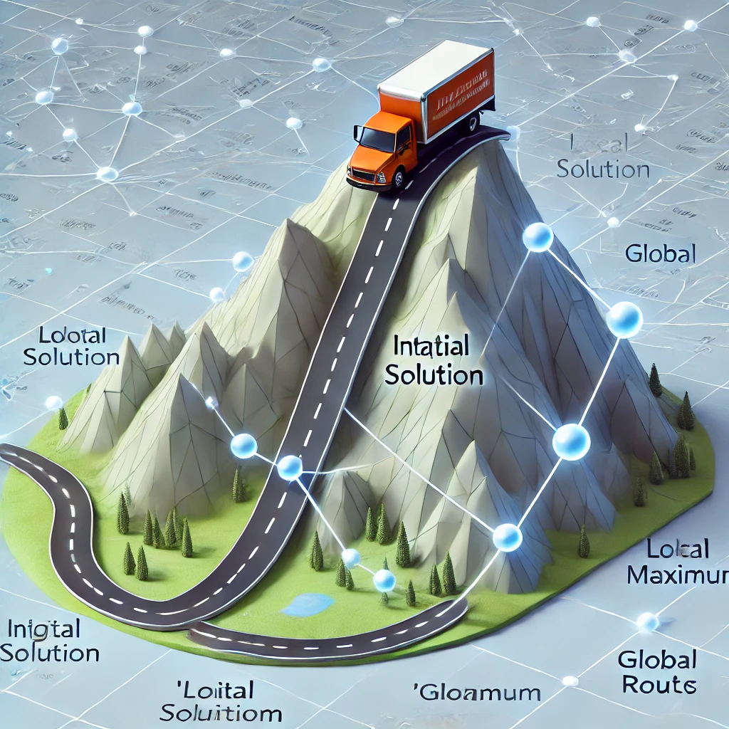
ROUTE OPTIMISATION FOR DELIVERY SYSTEM USING HILL CLIMB ALGORITHM
In this presentation we will explore the Hill Climb algorithm. This is for optimizing delivery routes and minimizing costs.
We'll cover the algorithm's core principles. We'll look at its advantages, limitations, and enhancements of it.

Slide 2

What is route optimisation:
Route optimization is the process of determining the most efficient route for a vehicle to reach destinations while minimizing travel time, fuel consumption, and costs. It helps delivery services, logistics companies, and transportation systems improve efficiency by considering factors like traffic, road conditions, and delivery priorities. By using optimization algorithms like Hill Climbing, businesses can dynamically adjust routes in real-time, reducing delays and enhancing customer satisfaction.

Slide 3
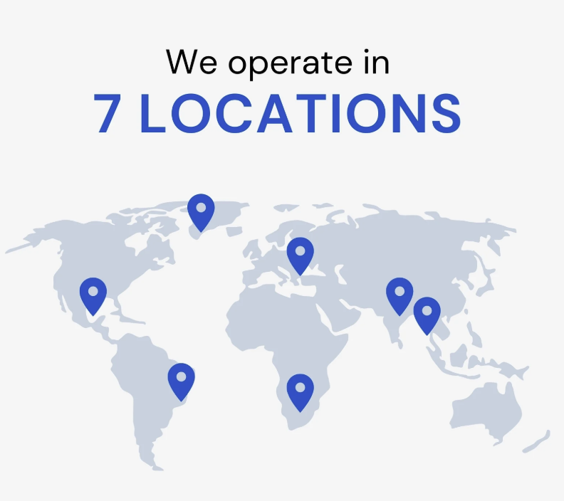
Why hill climbing:
Hill Climbing is an efficient algorithm for route optimization as it continuously improves a given path by making small changes. It quickly finds a good enough solution without checking all possibilities
The algorithm adapts to real-time changes like traffic or roadblocks, ensuring dynamic route adjustments. It is computationally lightweight, making it ideal for small to medium-sized delivery networks.

Slide 4
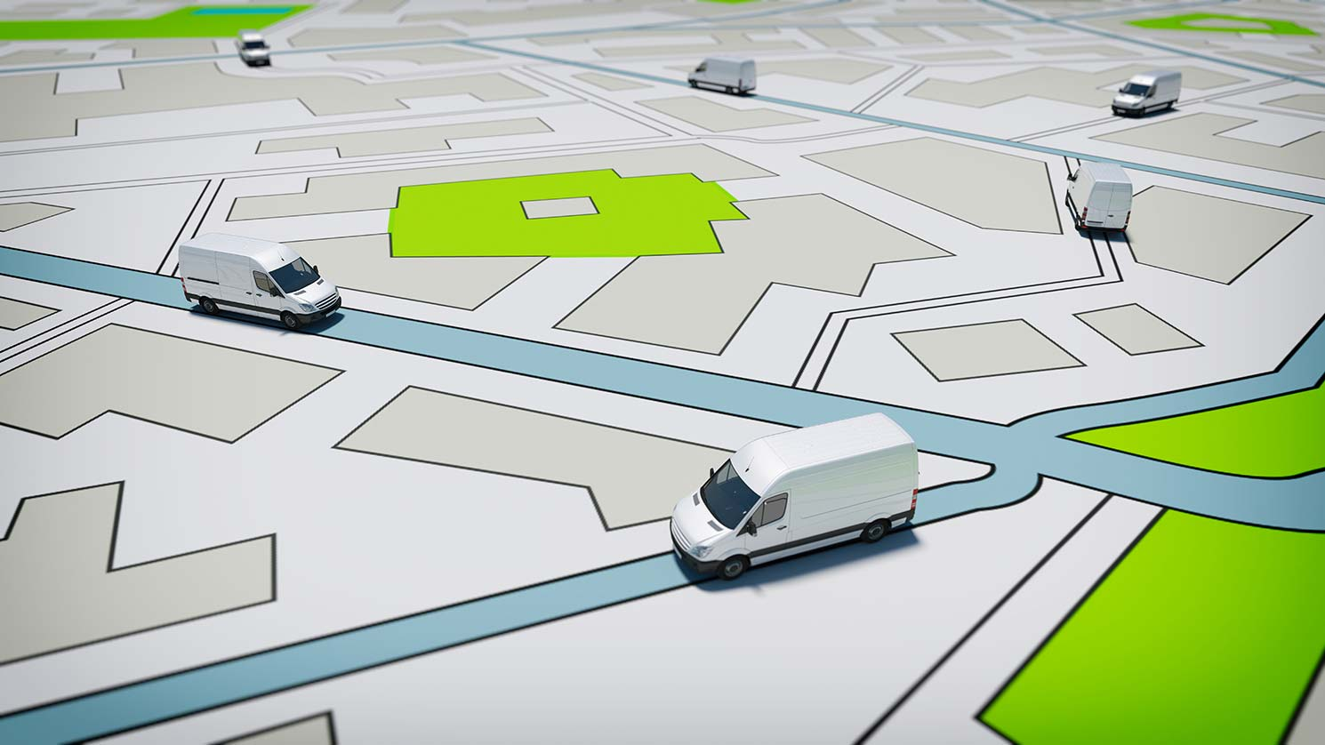
How hill climb algorithm works on route optimisation:
Hill Climbing in route optimization starts with an initial route and iteratively makes small modifications, such as reordering stops, to reduce travel time or distance. If a modification improves efficiency, it is accepted; otherwise, it is discarded. This process continues until no further improvements are possible, resulting in a locally optimized route. It is a fast and efficient method for small to medium-sized delivery networks.

Slide 5
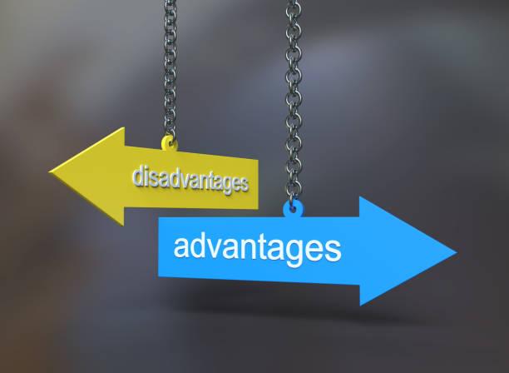
Disadvantages:
Stuck in local optima
No backtracking
Dependent on initial conditions
Limited exploration
Not ideal for large scale problems
May require multiple runs for better solution
Advantages:
Fast convergence
Simple implimentation
Adaptive to real life changes
Works well for small scale problems
No need for larger datasets
Low computational cost
provides quick solutions

Slide 6
Alternative Algorithms for Route Optimisation
When optimizing delivery routes, different algorithms offer various advantages and trade-offs. Below is a comparison of three popular algorithms:
Algorithm | Pros | Cons
Hill climbing | Fast, simple, and requires low computation | Can get stuck in local optima, no backtracking
Genetic Algorithm | Finds better solutions by exploring multiple paths | Requires high computing power and more time
A* | Guarantees the best possible route | Computationally expensive for large networks

Slide 7

Real world applications of hill climbing in route optimisation:
1️⃣ Food Delivery Services (e.g., Uber Eats, Zomato, DoorDash)
Optimizes delivery routes for drivers to reduce time and fuel consumption.
Adjusts routes dynamically based on traffic conditions.
2️⃣ Courier & Logistics Companies (e.g., FedEx, DHL, UPS)
Ensures faster package delivery by finding the shortest route.
Minimizes transportation costs while maximizing efficiency.
3️⃣ Ride-Sharing Services (e.g., Uber, Lyft)
Assigns optimal pickup and drop-off routes for drivers.
Reduces waiting time for passengers.
4️⃣ Public Transportation Scheduling
Helps in optimizing bus and train schedules for better time management.
Reduces congestion and improves passenger flow.
5️⃣ Smart Traffic Management
Assists in designing real-time traffic signals to ease congestion.
Optimizes road usage for emergency services like ambulances.

Slide 8

Challenges in Route Optimization
Traffic Congestion – Unexpected delays affecting delivery times.
Dynamic Weather Conditions – Roadblocks, flooding, or extreme weather affecting routes.
Local Optima in Hill Climbing – Getting stuck in a non-optimal route.
Multiple Delivery Constraints – Time windows, fuel efficiency, and package priorities.
Computational Limitations – Scalability challenges for large-scale networks.

Slide 9

Future Trends in Route Optimization
AI & Machine Learning Integration – Predictive analytics for better route decisions.
Autonomous Delivery Vehicles & Drones – Reducing human intervention in deliveries.
IoT-Based Smart Routing – Real-time vehicle tracking and automated rerouting.
Multi-Modal Delivery Systems – Combining road, air, and drone deliveries for efficiency.
Sustainable & Green Logistics – Optimizing routes for fuel efficiency & lower emissions.

Slide 10




Cost Savings from Route Optimization
Factor | Without Optimisation | With optimisation | Savings %
Fuel cost | High fuel usage | Lower due to shortest paths | 10-20%
Delivery Time | Delays, rerouting needed | Optimized routes reduce delays | 15-40%
Fleet Utilization | More vehicles required | Fewer vehicles covering more deliveries | 20-30%
Customer Refunds | Frequent delays, refunds | Timely deliveries reduce refunds | 5-15%
Driver Workload | Longer work hours | More efficient routes = shorter shifts | 10-25%

Slide 11

Conclusion:
The final reflections are:
Hill Climbing is a fast, efficient method for route optimization.
Best suited for small-scale & dynamic deliveries with real-time adjustments.
Future innovations (AI, IoT, Machine Learning) will make route optimization more accurate and scalable.
Final Thought:
"The future of delivery optimization lies in intelligent, real-time decision-making systems!"

